Slide 1
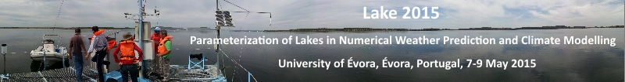
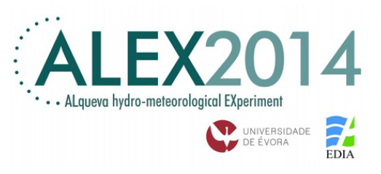

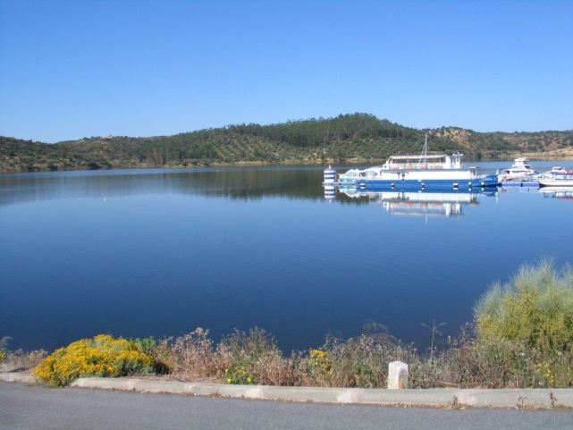
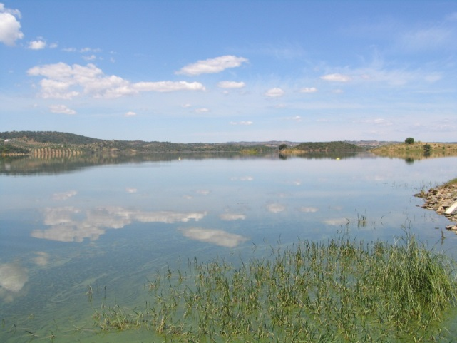
Ecological assessment of Mediterranean reservoirs: Alqueva reservoir as a case study
(Alentejo, Southern Portugal)
Manuela Morais, Maria Helena Novais, Susana Nunes, Joana Rosado, Alexandra Penha, Amely Zavattieri, Miguel Potes & Rui Salgado

Slide 2
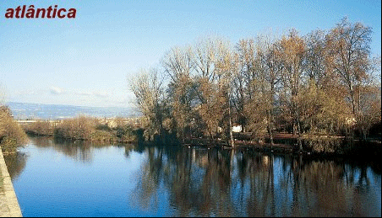
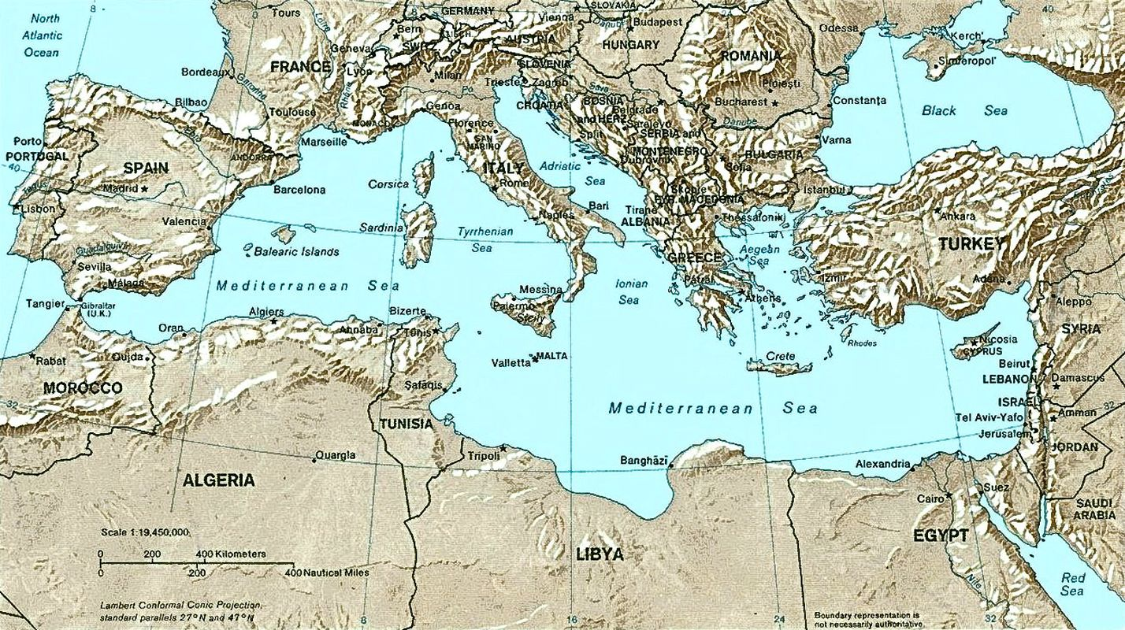
«Portugal is mediterranean by conditions, atlantic by position»
(Pequito Rebelo em “A Terra Portuguesa” – 1929)
Portugal is a crossroad of influences between the Mediterranean and the Atlantic, attentive to the complexity and to the reversibility of movements of a human geography (Guilherme d'Oliveira Martins)

Slide 3
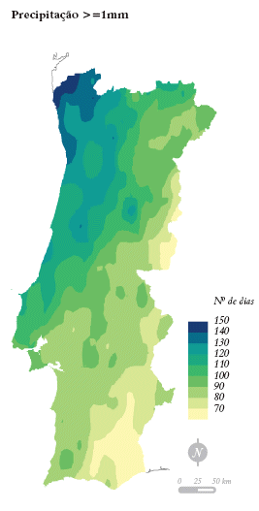
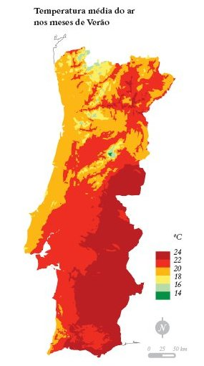
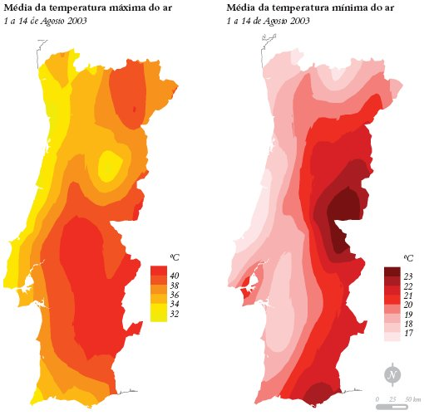
«Portugal is mediterranean by conditions, atlantic by position»
(Pequito Rebelo em “A Terra Portuguesa” – 1929)
Influence of the latitude, altitude and distance from the sea.

Slide 4
«Portugal is mediterranean by conditions, atlantic by position»
(Pequito Rebelo em “A Terra Portuguesa” – 1929)
Portugal is a crossroad of influences between the Mediterranean and the Atlantic, attentive to the complexity and to the reversibility of movements of a human geography (Guilherme d'Oliveira Martins)

Slide 5
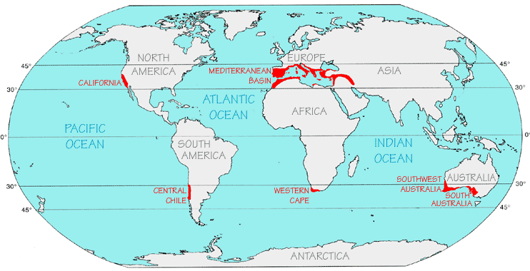
Mediterranean Climate Regions occur between 30°- 45° North and South of the Equator, in the west side of continents of the Mediterranean Basin, Middle East California, central Chile, Western Cape in South Africa, and the South West in Western Australia. Correspond only to 2% of the Earth’s land surface
Influenced by cold ocean currents, the Mediterranean climate is characterized by a moderately rainy winter and a hot dry summer.
Adapted from: Ecosystems of the World, Vol. II, Mediterranean-Type Shrublands (F. DiCastri, D.W. Goodall and R.L. Specht, Eds.), Elsevier, Amsterdam, 1981.

Slide 6
Water stress indicator:
A ratio of water withdrawal to water availability
Notes:
6

Slide 7
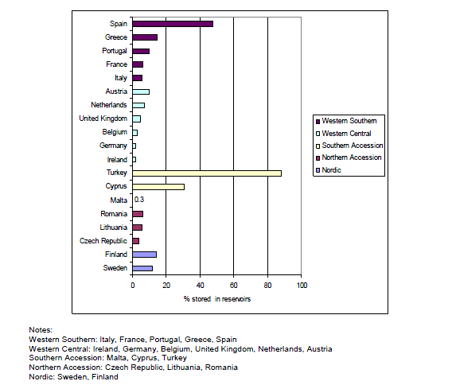
Proportion of total freshwater resources stored in reservoirs in Europe

Slide 8
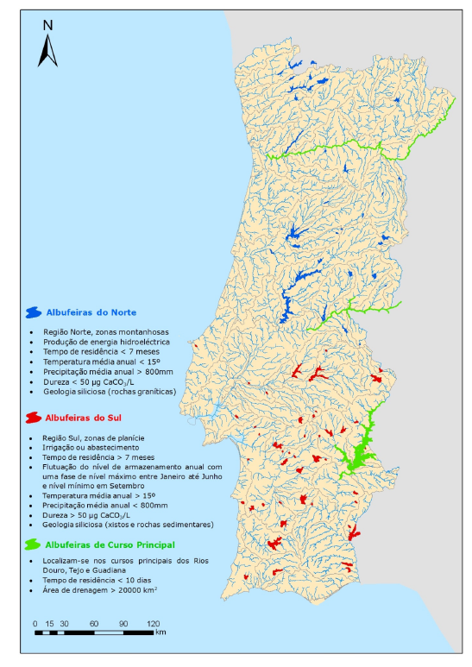
77 reservoirs in Portugal
organized in three abiotic types (WFD)
North;
South;
Main course;
Reservoirs are impoundments created by humans. They are being constructed on an unprecedented scale in response to the exponential water demands to human activities. Such alterations will result in major modifications in topography and regional climate that are not yet fully recognized or even partially understood.

Slide 9
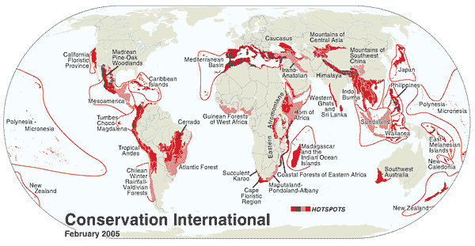
Conservation and biodiversity
The 34 hotspots identified by Conservation International cover 2.3 percent of the Earth's land surface, yet more than 50 percent of the world’s plant species and 42 percent of all terrestrial vertebrate species are endemic to these areas. All are threatened by human activities.
With many endemic species, Mediterranean is recognized as one of the first 25 Global Biodiversity Hotspots, with many endemic threatened species

Slide 10
Aditional
The total population of the Mediterranean countries grew from around 300 million in 1970 to 400 million in 2000 (a 1,4 % increase per year) and to 466 million in 2010. The population is predicted to reach 500 million by 2025.
This overgrowing population is increasing water resources pressure and requesting new water planning and management approaches

Slide 11
To go further on the understanding of the functioning of large and deep reservoirs during the summer period in the Mediterranean Region, Alqueva reservoir was studied from June until September 2014.
To do so, vertical profiles of temperature, dissolved oxygen, pH, oxidation-reduction potential and conductivity were monthly taken;
simultaneously, water samples were collected for physical-chemical analyses and an integrated sample, representative of the euphotic zone, was collected for phytoplankton identification and quantification.

Slide 12
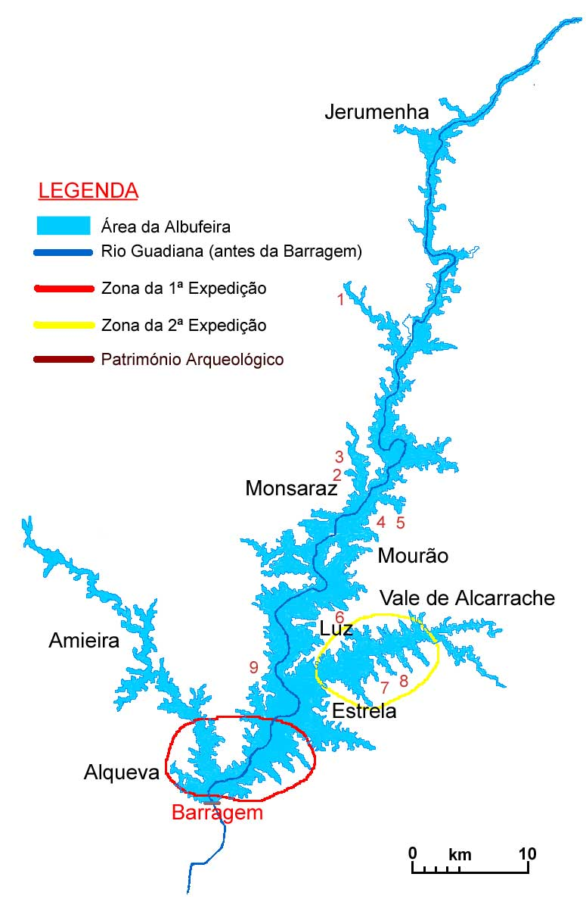
Three sites were chosen:
near the dam;
middle section;
Alcarrache triburary

Slide 13
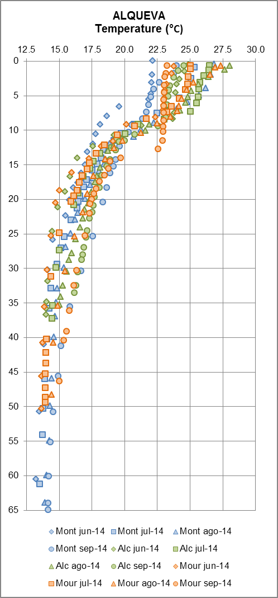
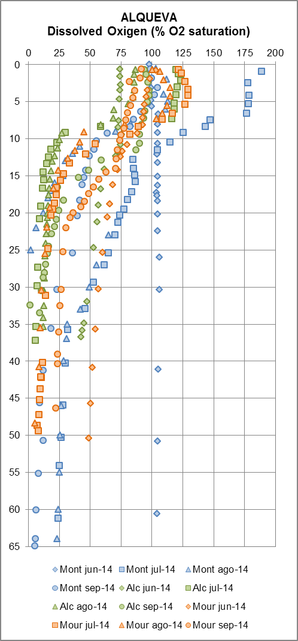
The thermocline is the transition layer between the mixed layer at the surface and the deep water layer.
In the thermocline, the temperature decreases rapidly from the mixed layer temperature to the much colder deep water temperature.
The mixed layer and the deep water layer are relatively uniform in temperature, while the thermocline represents the transition zone between the two.

Slide 14
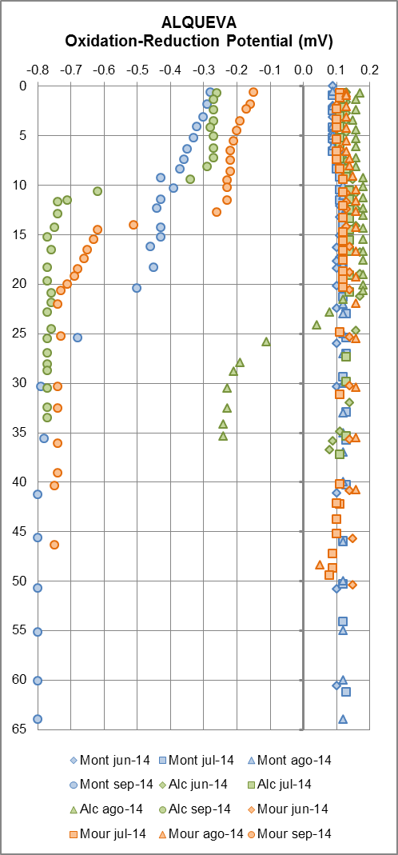
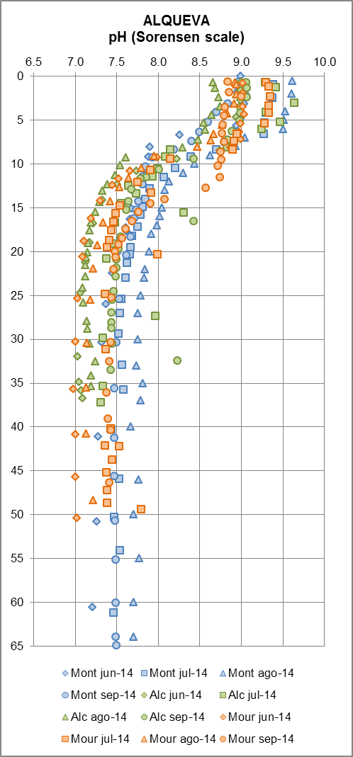

Slide 15
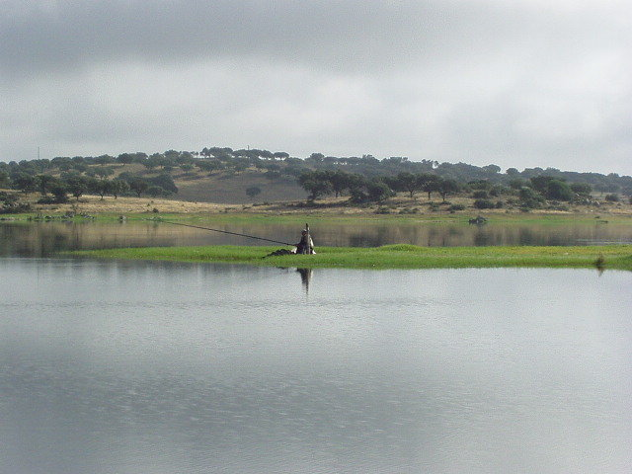
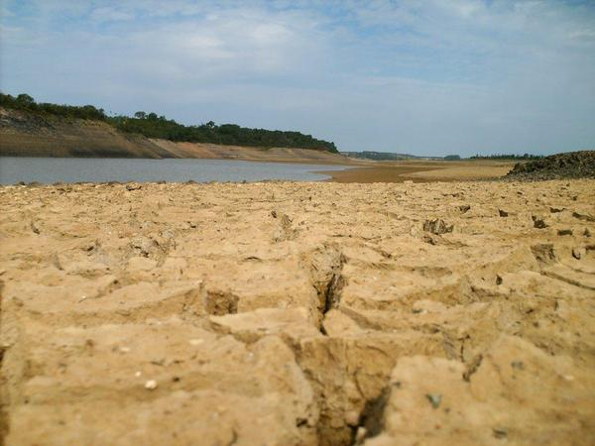
Enxoé reservoir

Slide 16
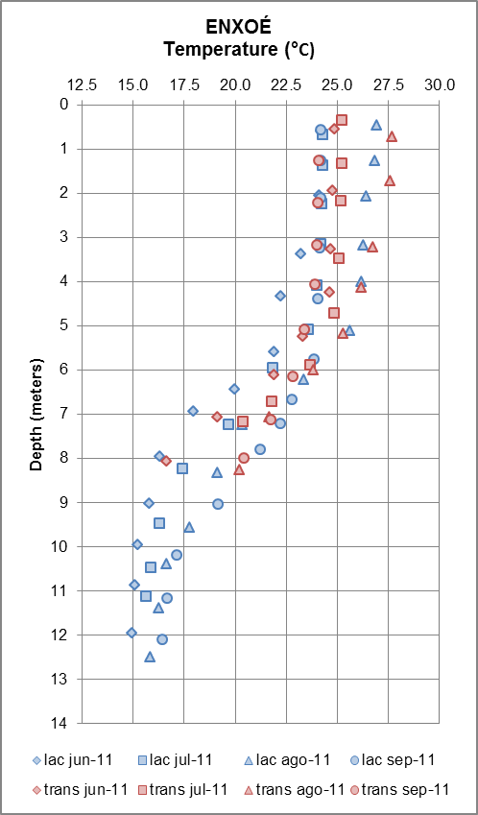
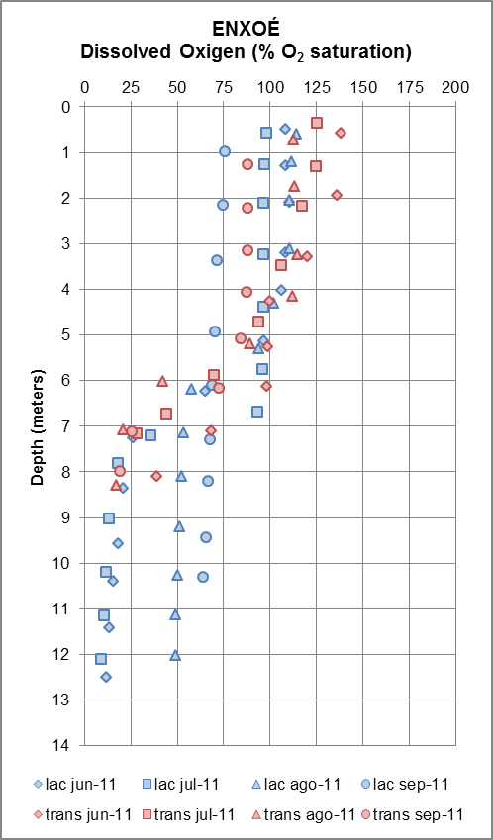

Slide 17
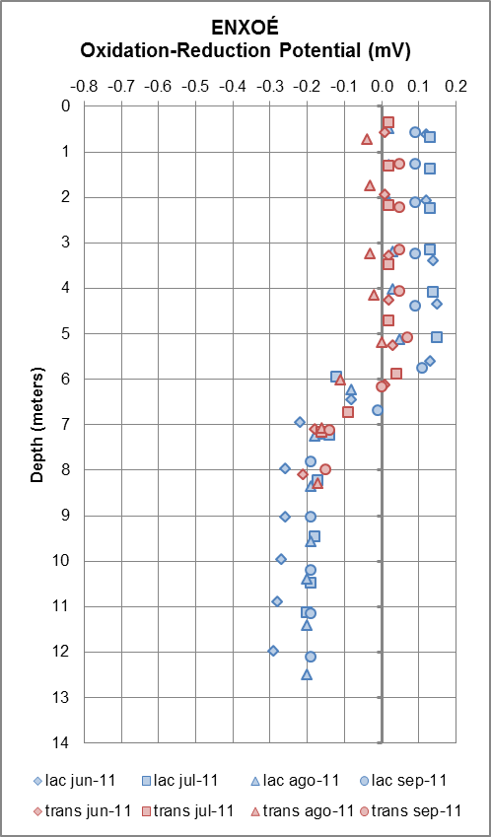
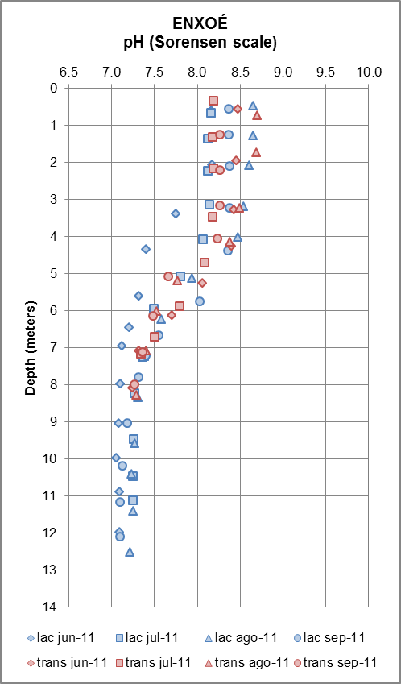

Slide 18
Alqueva reservoir

Slide 19
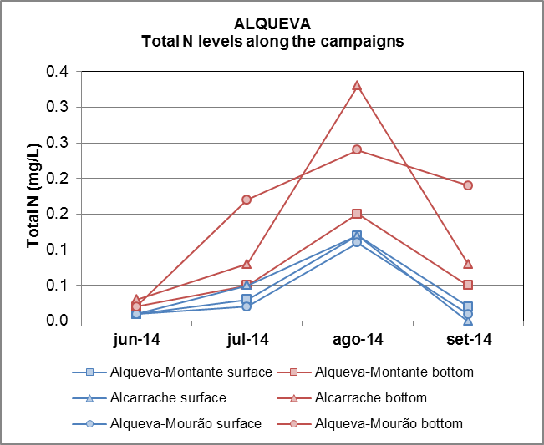
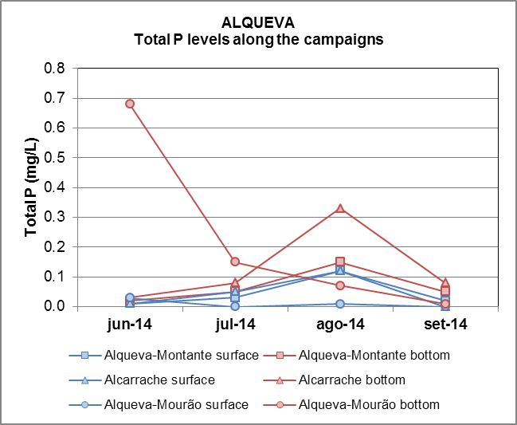
Nitrogen and Phosphorus levels
Good ecological potential (0,07mg/L)
OECD classification system Eutrophic (0,035mg/L)

Slide 20
Enxoé reservoir

Slide 21
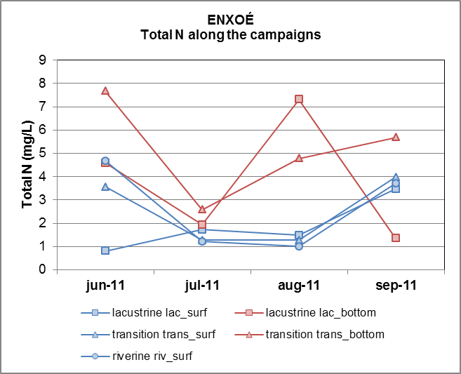
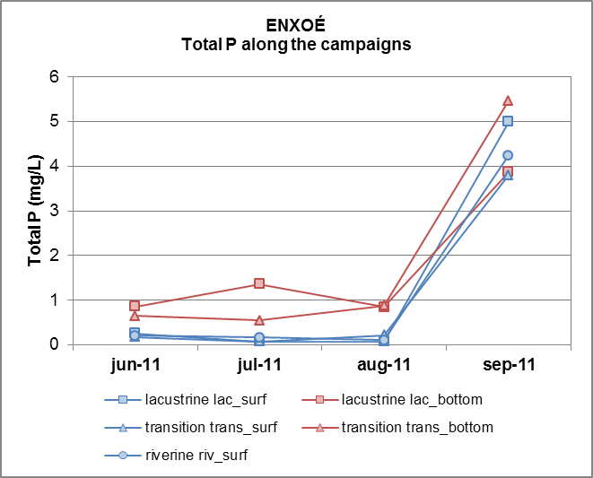
Nitrogen and Phosphorus levels
All the concentrations are higher than the thresholds for good ecological quality (0,07 mg/L) and for eutrophic status (0,035 mg/L)

Slide 22
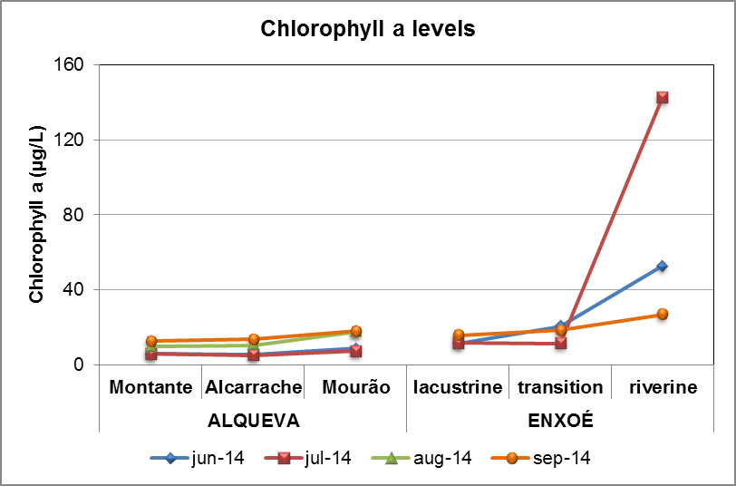
Chlorophyll a

Slide 23
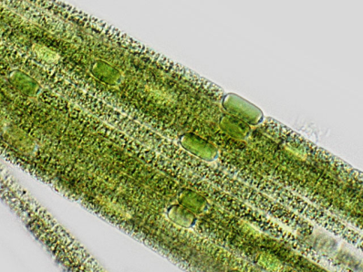
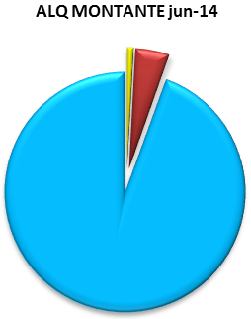
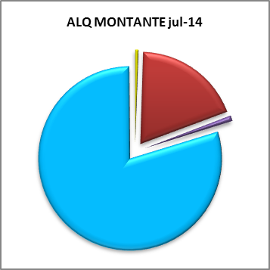
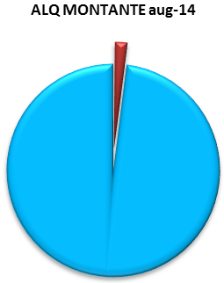
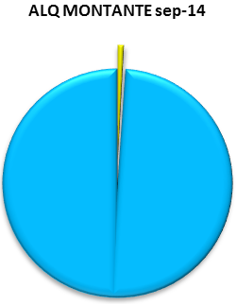
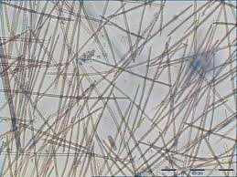
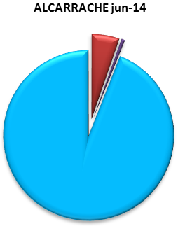
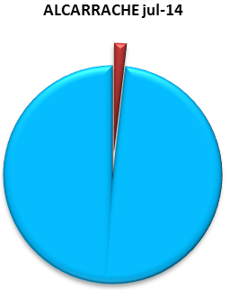
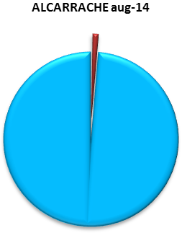
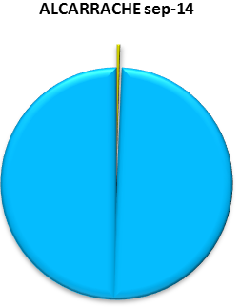
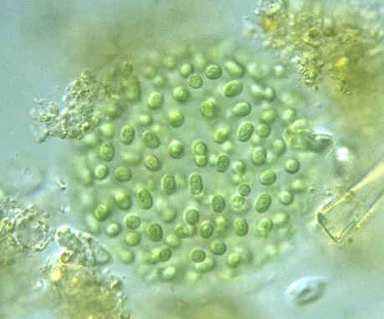
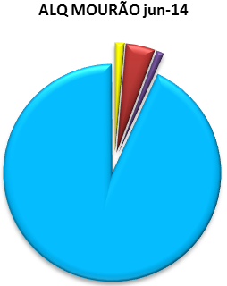

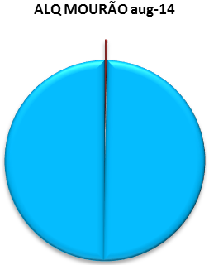

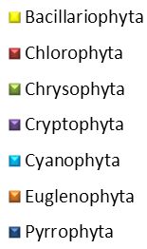
Phytoplankton in ALQUEVA reservoir
Aphanizomenon sp.
Cylindrospermopsis sp.
Aphanocapsa sp.

Slide 24
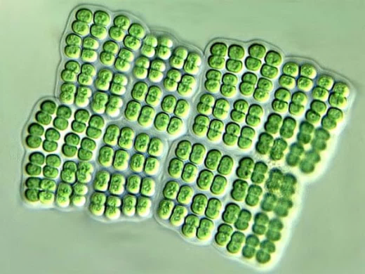
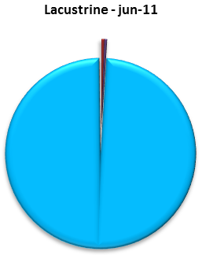
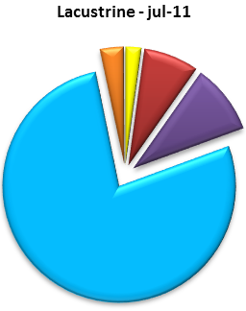
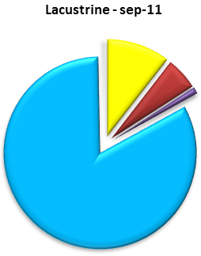
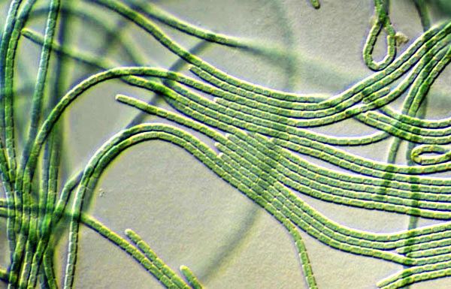

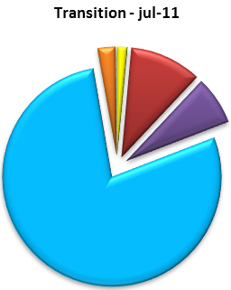
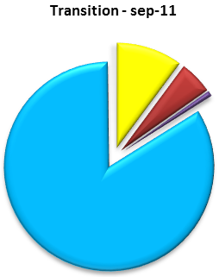




Phytoplankton in Enxoé reservoir
Merismopedia sp.
Oscillatoria sp.
Aphanizomenon sp.

Slide 25
Concluding
Given the trophic status of the Portuguese reservoirs, management strategies should be implemented in order to prevent the impairment of the ecological status and consequently the water quality.
All the abovementioned results contribute to improve the knowledge of the reservoir dynamics and therefore to propose adequate management measures to preserve the observed biological integrity.
Meteorological data greatly contribute to understand the abiotic and biotic temporal evolution of the system.
Water resources management is a complex matter of enormous strategic importance for a sustainable development in Mediterranean regions.

Slide 26

Obrigada

