Slide 1
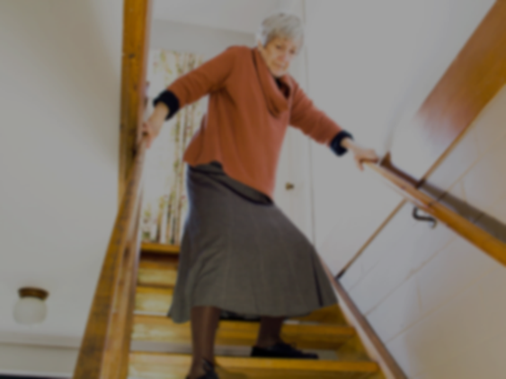
Analysis of the references of the nursing diagnoses Impaired Walking (00088)
Marques-Vieira, C.*; Sousa, L.; Agostinho, M.; Pontífice-Sousa, P.; Reis, G.; Oliveira, I.; Caldeira, S.
*cristina_marques@ics.lisboa.ucp.pt
Introduction:
The concept analysis is an important research method for the development of the nursing knowledge and it is suggested to be the first phase of the nursing diagnosis validation(1). NANDA-I taxonomy II of integrated nursing diagnoses is based on concept analysis and development as well as label, defining characteristics, related factors and references(2), that constitutes the elements of the diagnoses.
Objective:
To characterize the attributes; related concepts and clinical indicators from references of nursing diagnosis impaired walking.
Method:
Analysis of the concept impaired walking, according to Rodgers, among the 3 references of the nursing diagnosis from the last edition(2).
Results:
Attributes:
Getting up from a chair, sitting down, turning while walking, and raising the feet while walking(3), decreased force production, less motion and force, decreased gait speed(4), deterioration in physical health, fear of falling, curtail in activities, walk speed and distance(5).
Related Concepts:
Hip and knee flexion(3), impaired mobility, impairment in proprioceptive and vibratory sensory system, impaired balance, vestibular changes(4), environment hazard, fall history, lower balance, activity reduction, weight shifting ability, poor physical performance, global weakness, limits of stability (reduction) and lower limb weakness(5).
Clinical indicators:
Getting up from a chair, sitting down, turning while walking, and raising the feet while walking; the sensory and neuromuscular examination(3); impairment in proprioceptive and vibratory sensory systems; impaired balance, and vestibular changes; pharmaceutical variables; depression and impaired cognition(4),self efficacy level, limits of stability, walking speed and lower extremity muscle strength(5).
http://blog.safetytubs.com/234/home-improvement-tips-for-the-aging-and-elderly-part-3/
Conclusion:
The results are similar to the elements at the taxonomy II, but since the most recent reference is from 2004 it is desirable to develop clinical validation in order to contribute to the taxonomy improvement.
References:
(1) Rodgers, L., Knalf A. Concept development in nursing: foundations, techniques, and applications. 2nd ed. Philadephia: Saunders, 2000.
(2) Herdman, T. (Ed). Nursing diagnoses NANDA I: definitions and classification (2012-2014).Oxford: Wiley-Blackwell, 2012.
(3) Tinetti, M., Ginter, A.F. Identifying Mobility dysfunctions in elderly patients: Standard neuromuscular examination or direct assessment? JAMA, 1988, 259(8), 1190-1193.
(4) Lewis, C.L et all. Characteristics of Individuals Who Fell While Receiving Home Health Services. Physical Therapy, 2004, 84, 1.
(5) Brouwer, B., Musselman, K., Culham, E. Physical Function and health status among seniors with or without a fear of falling. Gerontology, 2004, 50, 135-141.

